Slide 1
Hidden Moving Target Defense in Smart Grids
Jue Tian^{1,2} Rui Tan² Xiaohong Guan^{1,3} Ting Liu^{1,4}
1. Xi’an Jiaotong University, P.R. China
2. Nanyang Technological University, Singapore
3. Tsinghua University, P.R. China
4. Cornell University, U.S.

Slide 2
Motivation
59% attacks on critical infrastructures target grid [US DHS’13]
Night Dragon: grid data exfiltration [McAfee’11]
Dragonfly: Trojan horses in grid control systems [Symantec’14]
BlackEnergy Trojan shut down 1.4 million people’s power supply in Ukraine [WeLiveSecurity’15]

Slide 3
State Estimation
DC State estimation
Input: line flow z
Output: voltage phase estimation
Bad data detection (BDD)
Bad data exists!
Measured data
Estimated data
Notes:
State estimation is used in system monitoring to best estimate the power grid state
through analysis of meter measurement data and power system models.
In POWER GRID, state estimation means estimating State Variables from the Meter Measurements.
The meter measurements may include bus voltages, bus real and reactive power injections, and branch reactive power flows in every subsystem of a power grid.
The state variables include all the bus voltages and the angles of bus voltages. If the number of buses is n, then the number of state variables if 2*n-1.
Usually the number of Meter Measurement is much more than that of state variables.
The whole power grid can be modeled as AC power flow model or DC power flow model.

Slide 4
Moving Target Defense
False data injection
Corrupt measurements
Bypass BDD [Liu CCS’09]
Moving target defense (MTD)
Lines are equipped with distributed flexible ac transmission system (D-FACTS) devices
Actively perturbs line susceptances [Rahman MTD’14]
Attack vector
DETECTED!
Notes:
State estimation is used in system monitoring to best estimate the power grid state
through analysis of meter measurement data and power system models.
In POWER GRID, state estimation means estimating State Variables from the Meter Measurements.
The meter measurements may include bus voltages, bus real and reactive power injections, and branch reactive power flows in every subsystem of a power grid.
The state variables include all the bus voltages and the angles of bus voltages. If the number of buses is n, then the number of state variables if 2*n-1.
Usually the number of Meter Measurement is much more than that of state variables.
The whole power grid can be modeled as AC power flow model or DC power flow model.

Slide 5
Outline
Motivation and background
Problem statement
Construction and properties of hidden MTD
Simulations
Notes:
State estimation is used in system monitoring to best estimate the power grid state
through analysis of meter measurement data and power system models.
In POWER GRID, state estimation means estimating State Variables from the Meter Measurements.
The meter measurements may include bus voltages, bus real and reactive power injections, and branch reactive power flows in every subsystem of a power grid.
The state variables include all the bus voltages and the angles of bus voltages. If the number of buses is n, then the number of state variables if 2*n-1.
Usually the number of Meter Measurement is much more than that of state variables.
The whole power grid can be modeled as AC power flow model or DC power flow model.

Slide 6
More Intelligent Attacker
Detect the activation of MTD using BDD
MTD activation detection drives the attacker to obtain new H Risk is not substantially reduced
OK!
MTD has been activated
Launch the attack
Cancel the original attack plan
Notes:
State estimation is used in system monitoring to best estimate the power grid state
through analysis of meter measurement data and power system models.
In POWER GRID, state estimation means estimating State Variables from the Meter Measurements.
The meter measurements may include bus voltages, bus real and reactive power injections, and branch reactive power flows in every subsystem of a power grid.
The state variables include all the bus voltages and the angles of bus voltages. If the number of buses is n, then the number of state variables if 2*n-1.
Usually the number of Meter Measurement is much more than that of state variables.
The whole power grid can be modeled as AC power flow model or DC power flow model.

Slide 7
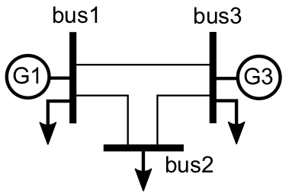
Example
Arbitrary MTD is not stealthy to attacker
Existing method [Rahman MTD’14]
arbitrary
D
Figure: 3-bus system.
Table: Arbitrary MTD approach.
Case
Original |  |  |  | -107.3 | -24.7 | 62.7 | 0
After MTD | -1.98 | 0 | 0 | -110.2 | -21.8 | 59.8 | 5.1
Not stealthy!
Notes:
State estimation is used in system monitoring to best estimate the power grid state
through analysis of meter measurement data and power system models.
In POWER GRID, state estimation means estimating State Variables from the Meter Measurements.
The meter measurements may include bus voltages, bus real and reactive power injections, and branch reactive power flows in every subsystem of a power grid.
The state variables include all the bus voltages and the angles of bus voltages. If the number of buses is n, then the number of state variables if 2*n-1.
Usually the number of Meter Measurement is much more than that of state variables.
The whole power grid can be modeled as AC power flow model or DC power flow model.

Slide 8
Hidden MTD
New MTD strategies
Hidden MTD:
Stealthy to attacker
Power flow invariant MTD (PFI-MTD)
Power flows remain unchanged after MTD
Research questions
Equivalence btw hidden and PFI?
How to construct hidden MTD?
Existence condition of hidden MTD?
Hidden MTD
PFI-MTD
Notes:
State estimation is used in system monitoring to best estimate the power grid state
through analysis of meter measurement data and power system models.
In POWER GRID, state estimation means estimating State Variables from the Meter Measurements.
The meter measurements may include bus voltages, bus real and reactive power injections, and branch reactive power flows in every subsystem of a power grid.
The state variables include all the bus voltages and the angles of bus voltages. If the number of buses is n, then the number of state variables if 2*n-1.
Usually the number of Meter Measurement is much more than that of state variables.
The whole power grid can be modeled as AC power flow model or DC power flow model.

Slide 9
Outline
Motivation and background
Problem statement
Construction and properties of hidden MTD
Simulations
Notes:
State estimation is used in system monitoring to best estimate the power grid state
through analysis of meter measurement data and power system models.
In POWER GRID, state estimation means estimating State Variables from the Meter Measurements.
The meter measurements may include bus voltages, bus real and reactive power injections, and branch reactive power flows in every subsystem of a power grid.
The state variables include all the bus voltages and the angles of bus voltages. If the number of buses is n, then the number of state variables if 2*n-1.
Usually the number of Meter Measurement is much more than that of state variables.
The whole power grid can be modeled as AC power flow model or DC power flow model.

Slide 10
Equivalence btw Hidden and PFI (1)
Condition for PFI-MTD
Lemma：An MTD H’ is a PFI-MTD if and only if there exists x’’, such that Hx = H’x’’.
D
D
D
Intuition: MTD
Only if PFI-MTD→
If H’ has full column-rank, then x’’ is unique.
From ,
Figure: 3-bus system.
Table: PFI-MTD approach.
Case
Original |  |  |  | -107.3 | -24.7 | 62.7 | -3.10 | -0.81 | 0
After PFI-MTD | -1.04 | 0.83 | -1.47 | -107.3 | -24.7 | 62.7 | -2.94 | -0.85 | 0
Stealthy!
Notes:
State estimation is used in system monitoring to best estimate the power grid state
through analysis of meter measurement data and power system models.
In POWER GRID, state estimation means estimating State Variables from the Meter Measurements.
The meter measurements may include bus voltages, bus real and reactive power injections, and branch reactive power flows in every subsystem of a power grid.
The state variables include all the bus voltages and the angles of bus voltages. If the number of buses is n, then the number of state variables if 2*n-1.
Usually the number of Meter Measurement is much more than that of state variables.
The whole power grid can be modeled as AC power flow model or DC power flow model.

Slide 11
Equivalence btw Hidden and PFI (2)
Proposition：An MTD is a hidden MTD if and only if it is a PFI-MTD.
Hidden MTD
PFI-MTD
Intuition of Hidden MTD → PFI-MTD
MTD:
Hidden MTD: ( can bypass BDD based on H)
From Lemma, hidden MTD H’ is PFI-MTD.
Notes:
State estimation is used in system monitoring to best estimate the power grid state
through analysis of meter measurement data and power system models.
In POWER GRID, state estimation means estimating State Variables from the Meter Measurements.
The meter measurements may include bus voltages, bus real and reactive power injections, and branch reactive power flows in every subsystem of a power grid.
The state variables include all the bus voltages and the angles of bus voltages. If the number of buses is n, then the number of state variables if 2*n-1.
Usually the number of Meter Measurement is much more than that of state variables.
The whole power grid can be modeled as AC power flow model or DC power flow model.

Slide 12
Construction of Hidden MTD
Lemma：An MTD H’ is a PFI-MTD if and only if there exists x’’, such that Hx = H’x’’.
Directly calculate H’
Choose the system state after MTD x’’
Difficult!
Compute the H’ according to
H’ is a Huge matrix!
For 118-bus system,
Notes:
State estimation is used in system monitoring to best estimate the power grid state
through analysis of meter measurement data and power system models.
In POWER GRID, state estimation means estimating State Variables from the Meter Measurements.
The meter measurements may include bus voltages, bus real and reactive power injections, and branch reactive power flows in every subsystem of a power grid.
The state variables include all the bus voltages and the angles of bus voltages. If the number of buses is n, then the number of state variables if 2*n-1.
Usually the number of Meter Measurement is much more than that of state variables.
The whole power grid can be modeled as AC power flow model or DC power flow model.

Slide 13
Existence of Hidden MTD
If and only if
: immutable part of H
Only related to D-FACTS deployment
D
Notes:
State estimation is used in system monitoring to best estimate the power grid state
through analysis of meter measurement data and power system models.
In POWER GRID, state estimation means estimating State Variables from the Meter Measurements.
The meter measurements may include bus voltages, bus real and reactive power injections, and branch reactive power flows in every subsystem of a power grid.
The state variables include all the bus voltages and the angles of bus voltages. If the number of buses is n, then the number of state variables if 2*n-1.
Usually the number of Meter Measurement is much more than that of state variables.
The whole power grid can be modeled as AC power flow model or DC power flow model.

Slide 14
Existence of Hidden MTD
If and only if
: immutable part of H
Only related to D-FACTS deployment
D
D
Notes:
State estimation is used in system monitoring to best estimate the power grid state
through analysis of meter measurement data and power system models.
In POWER GRID, state estimation means estimating State Variables from the Meter Measurements.
The meter measurements may include bus voltages, bus real and reactive power injections, and branch reactive power flows in every subsystem of a power grid.
The state variables include all the bus voltages and the angles of bus voltages. If the number of buses is n, then the number of state variables if 2*n-1.
Usually the number of Meter Measurement is much more than that of state variables.
The whole power grid can be modeled as AC power flow model or DC power flow model.

Slide 15
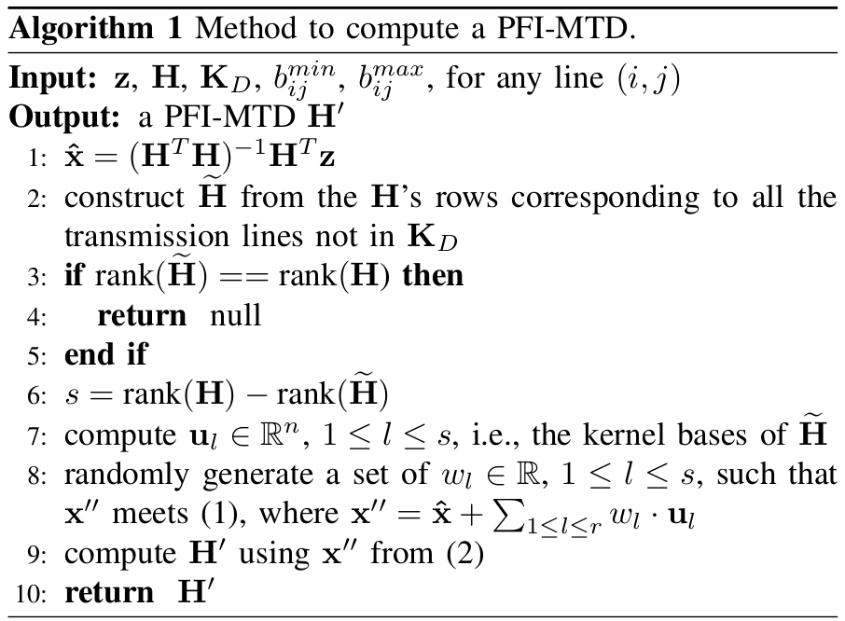
Hidden MTD Construction Algorithm
Existence condition
Construct new H’
Notes:
State estimation is used in system monitoring to best estimate the power grid state
through analysis of meter measurement data and power system models.
In POWER GRID, state estimation means estimating State Variables from the Meter Measurements.
The meter measurements may include bus voltages, bus real and reactive power injections, and branch reactive power flows in every subsystem of a power grid.
The state variables include all the bus voltages and the angles of bus voltages. If the number of buses is n, then the number of state variables if 2*n-1.
Usually the number of Meter Measurement is much more than that of state variables.
The whole power grid can be modeled as AC power flow model or DC power flow model.

Slide 16
Outline
Motivation and background
Problem statement
Construction and properties of hidden MTD
Simulations
Notes:
State estimation is used in system monitoring to best estimate the power grid state
through analysis of meter measurement data and power system models.
In POWER GRID, state estimation means estimating State Variables from the Meter Measurements.
The meter measurements may include bus voltages, bus real and reactive power injections, and branch reactive power flows in every subsystem of a power grid.
The state variables include all the bus voltages and the angles of bus voltages. If the number of buses is n, then the number of state variables if 2*n-1.
Usually the number of Meter Measurement is much more than that of state variables.
The whole power grid can be modeled as AC power flow model or DC power flow model.

Slide 17
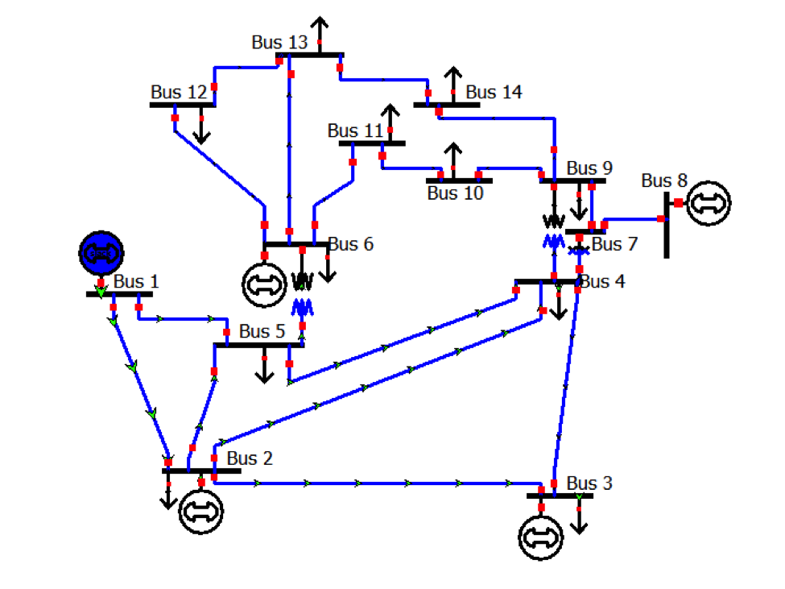
Simulation Setting
Matlab & Matpower Toolbox
IEEE 14-bus system
All lines are D-FACTS equipped
Measurement noise and threshold
Noiseless: threshold
Noisy:
Figure: 14-bus system
with false alarm rate 5%.

Slide 18
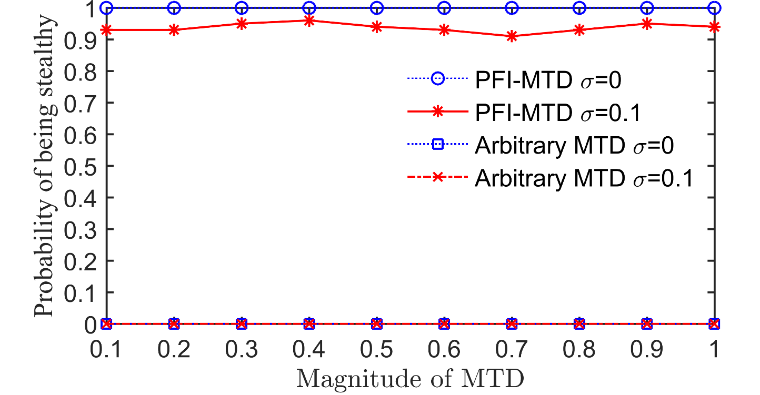
MTD Stealthiness
Magnitude of MTD: q
Adjusting capability of line susceptance
General setting: 20%; Low load condition: much larger (e.g., 90%)
Notes:
PFI-MTD is always stealthy when noiseless.
Noise slightly reduce MTD’s stealthy.
Arbitrary MTD is not stealthy.

Slide 19
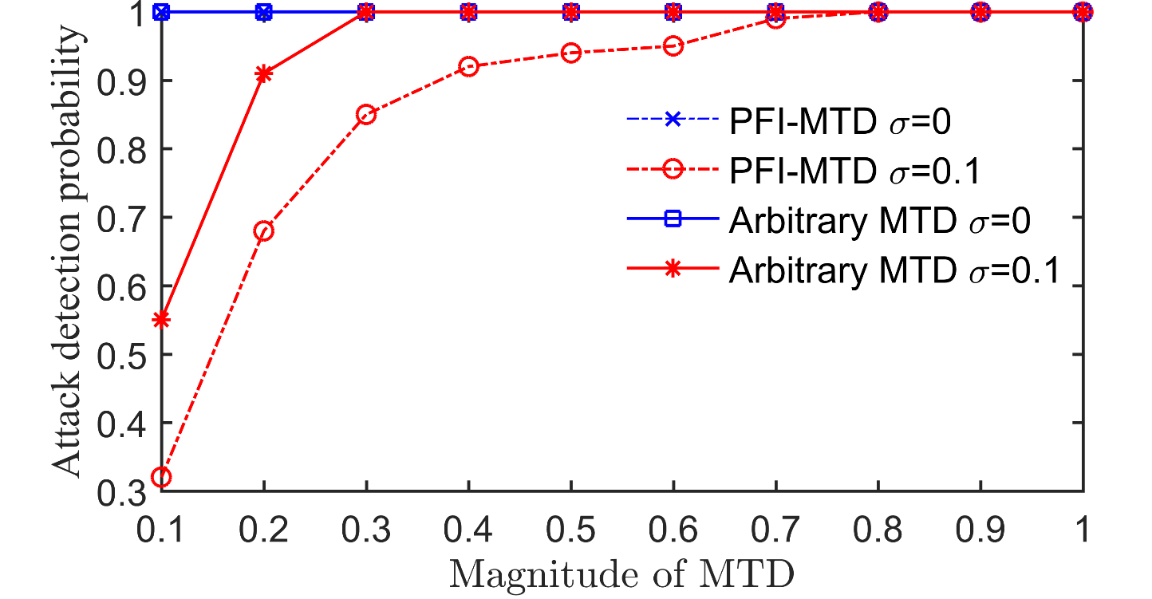
Attack Detection Probability
Attacker is able to corrupt measurements of all sensors
FDI attack with small magnitude

Slide 20
Conclusion
MTD under a more adversary setting
Attacker can detect the activation of arbitrary MTD
Hidden MTD
Equivalence to power flow invariant MTD
Construction algorithm
Existence condition
Ongoing work
Hidden MTD under ac power flow model
Hidden MTD’s completeness

